Slide 1
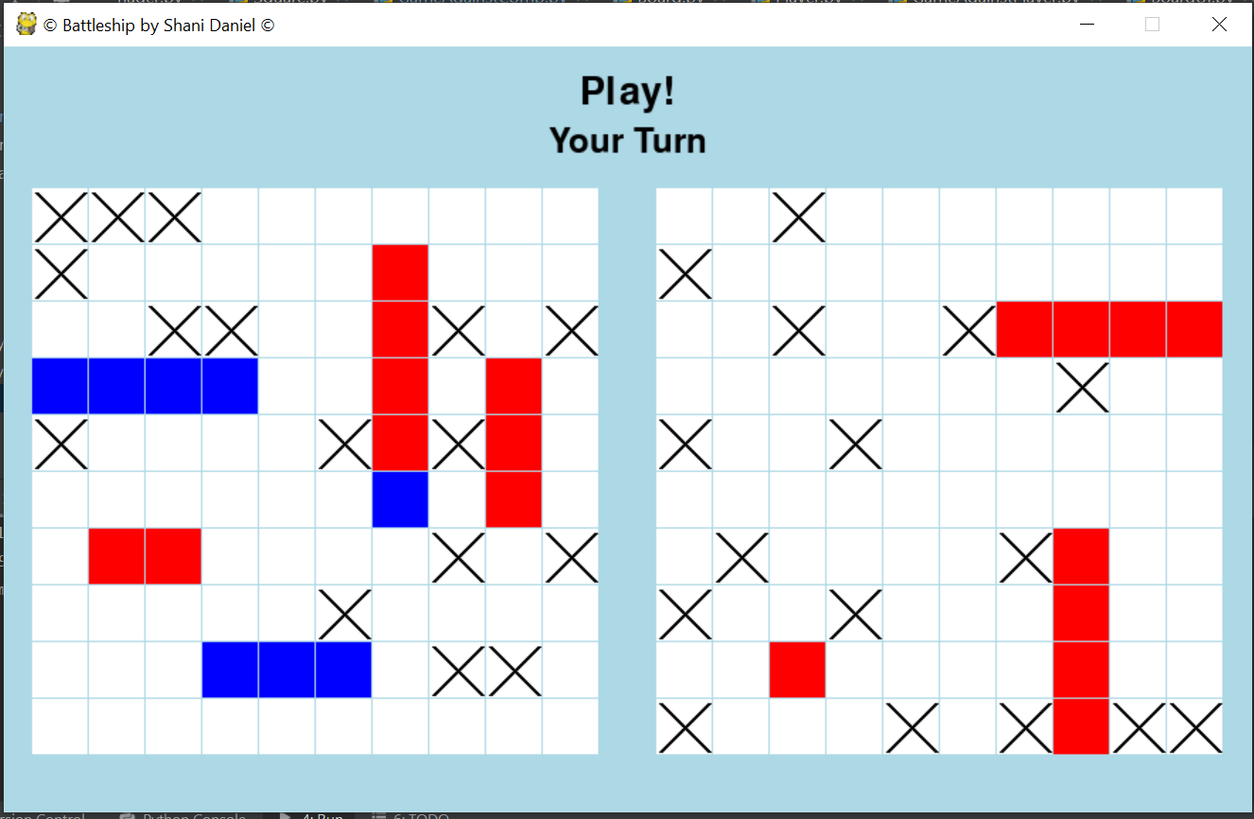
Battleship
By Shani Daniel

Slide 2

Introduction

Slide 3
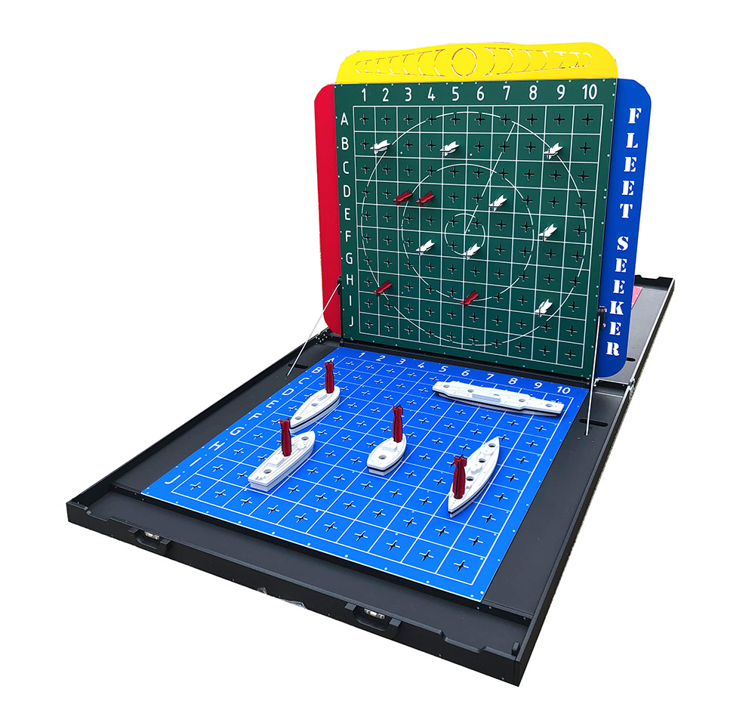
What is battleship?
Strategy game
2 Players
Locate ships on your board
Find your opponents’ ships

Slide 4



What does my program contain?
Uses management
____________________________________________________________________
Login
Registration
Edit/delete profile
Game
____________________________________________________________________
vs. Computer
PvP
Statistics
____________________________________________________________________
Leaderboard
Personal wins

Slide 5



Technology
GUI
Python Framework
SQL Server Database
Python packages:
tkinter
ttkthemes
pygame
PyCharm IDE
Profiles
Authentication
Users’ games statistics
python package - pyodbc

Slide 6
Architecture & flow
Registration
Login
Menu
Game - won / lost
statistics
Database
Statistics

Slide 7
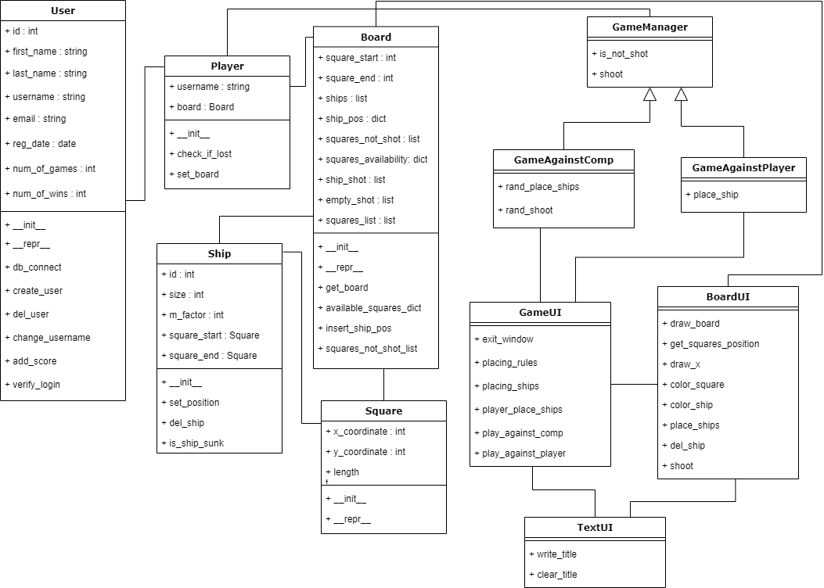
UML classes - OOP diagram

Slide 8
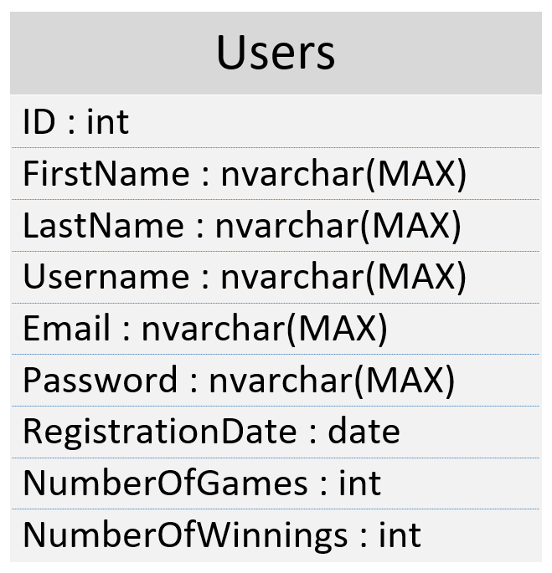
Database structure
The DB contains one table that manages the users and saves their statistics

Slide 9
User Interface

Slide 10
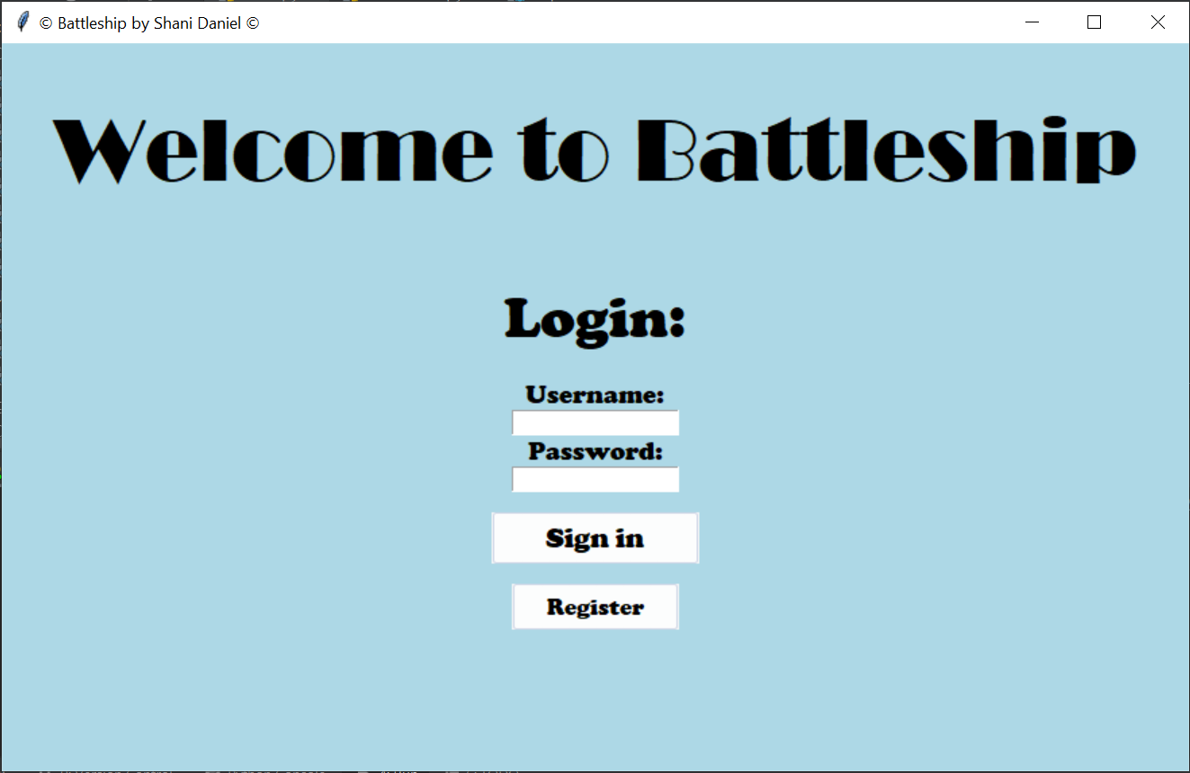
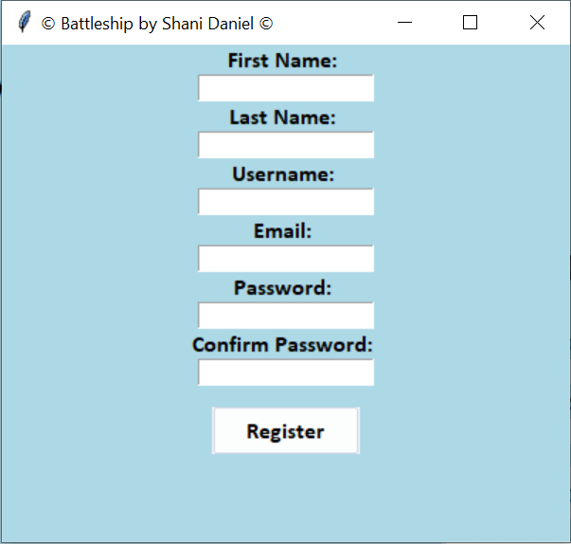
Login and registration

Slide 11
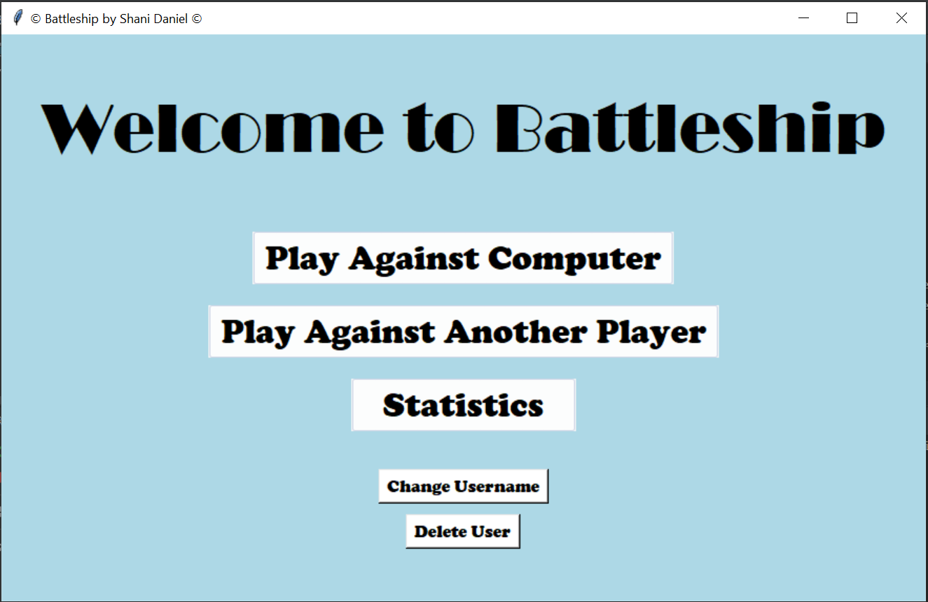
Main menu

Slide 12
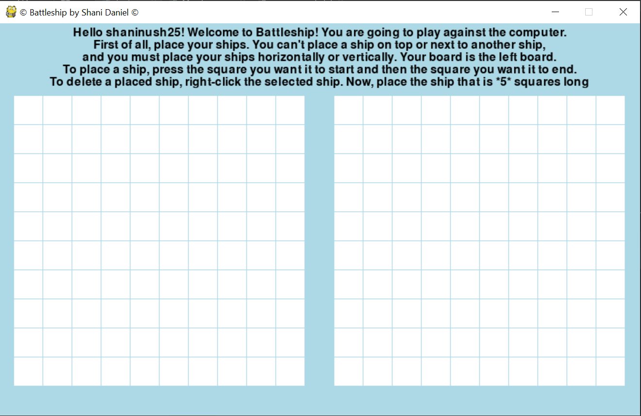
Game screen

Slide 13
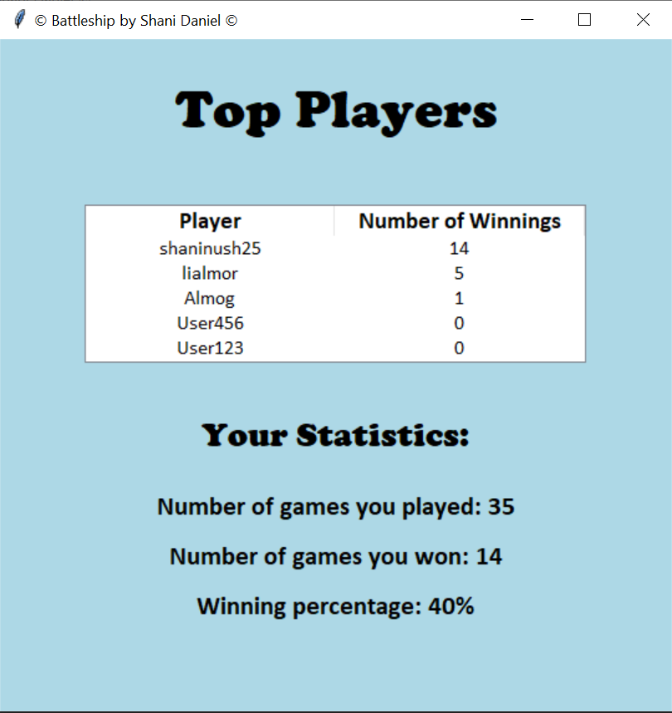
Statistics

Slide 14
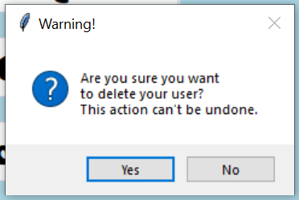
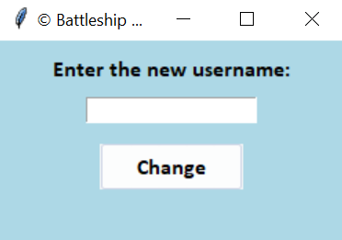
Extra features
Delete User
Change Username

Slide 15
Live Demo

Slide 16
Future additions
Making the game against another player online, so 2 registered players can play from different computers
Adding better AI to the computer, so it will call the shots with certain logic that acts more like a human player
Giving players an option to edit the game board size / ships sizes and making it more diverse

Slide 17
So have fun & go play!

Slide 18
Appendix

Slide 19
Game play
Battleship is a strategy type guessing game for two players.
Each player has a board (grid), on which the player's fleet of ships (battleships) are marked (by his choice of positioning).
The locations of the fleets are concealed from the opponent player. Players alternate turns calling "shots" at the other player's ships, and the objective of the game is to destroy the opposing player's fleet.
The player wins when he finds all the opponent’s ships.
The game is played on a 10x10 board, with 5 ships – a ship sizes 2 squares, 2 ships sized 3 squares, a ship sized 4 squares and a ship sized 5 squares. A ship must be placed horizontally or vertically (not diagonally), and can’t be placed on or next to another ship.

